Slide 1



Technical Architecture
Overview

Slide 2

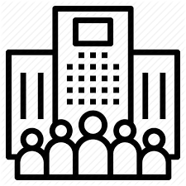
FAC Network Architecture
1. Participant
Investors
Funds Servicing
Fund Manager
Cash Exchange
Each participant operates their own node, interacting via the web GUI or by API and secures the private keys required to sign transactions on the node.
2. Nodes
FAC Node CorDapp
FAC Node CorDapp
FAC Node CorDapp
FAC Node CorDapp
Nodes can be hosted on premises, with preferred cloud provider or by the Network Operator as a managed service (preferred)
3. Network
Corda Messaging (P2P AMQP over TLS)
Nodes interact over a P2P Corda network managed centrally by a Business Network Operator who controls access to the network and provides network level services
Identity and Access
Network
Directory
Network
Notary
Network
Monitoring
Software
Deployment

Slide 3
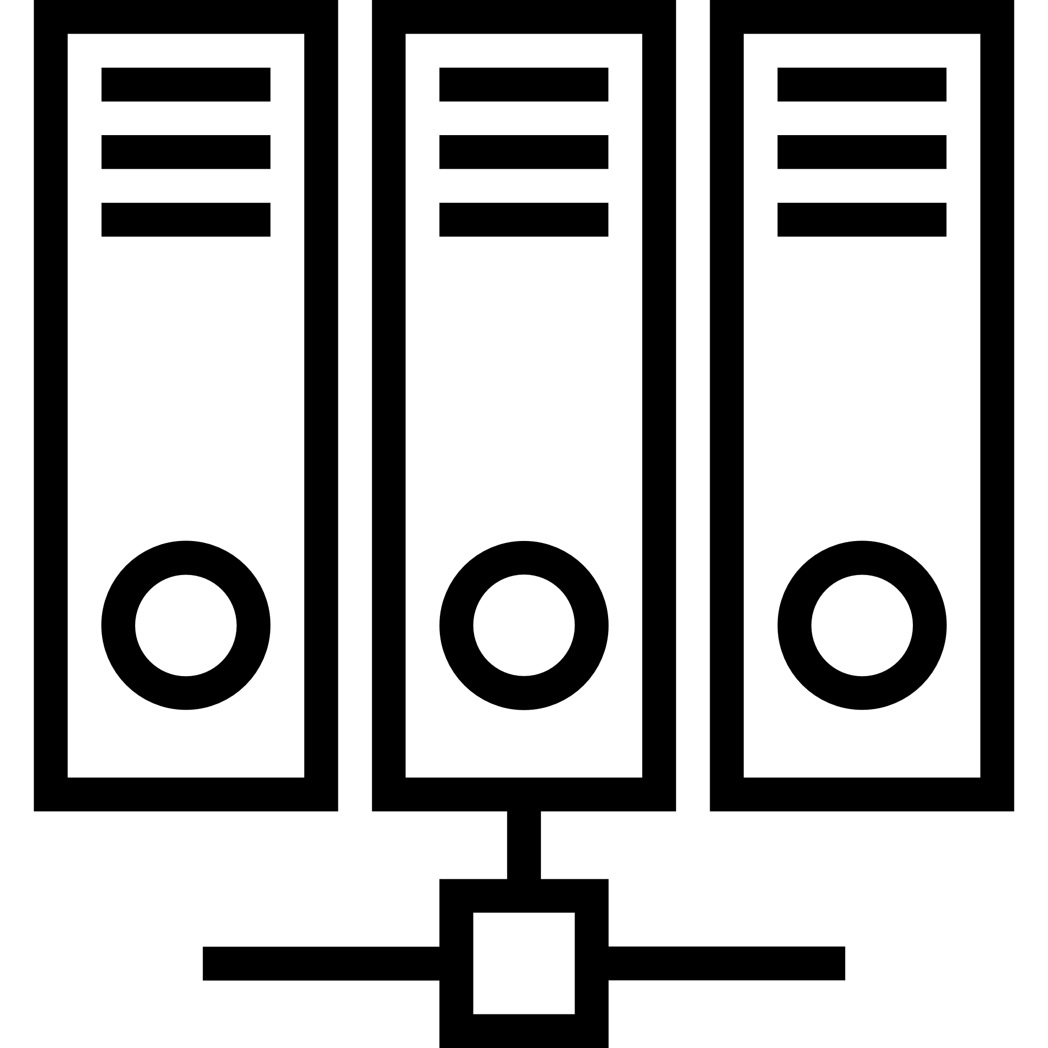
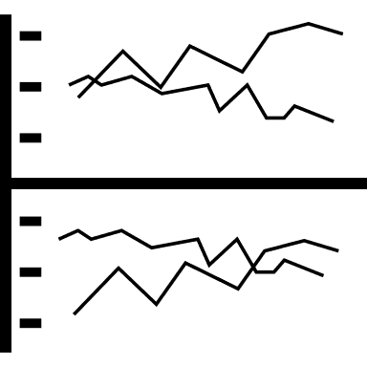



FAC Node Architecture
FAC User
Enterprise
Application
Data
Provider
API Integration
FAC DL Network
Web
Application
Datastore
Node Software Stack
Ubuntu
Corda Distributed App (Kotlin)
Apache Artemis (AMQP)
PostGreSQL Database
JVM (OpenJDK)
Nginx webserver
Web application (Webpack/ReactJS/MaterialUI)
Jasper Reports
Open LDAP
Vault
CorDapp
Node Deployment
Nodes are deployed fully configured by the network operator in a containerised form.
Report Server
FAC NODE

